Slide 1

StartUp Saturday Presentation

Slide 2
user
Web Page
View
Registration
Contact Us
Lenskart Team

Slide 3
Home Page

Slide 4


Slide 5
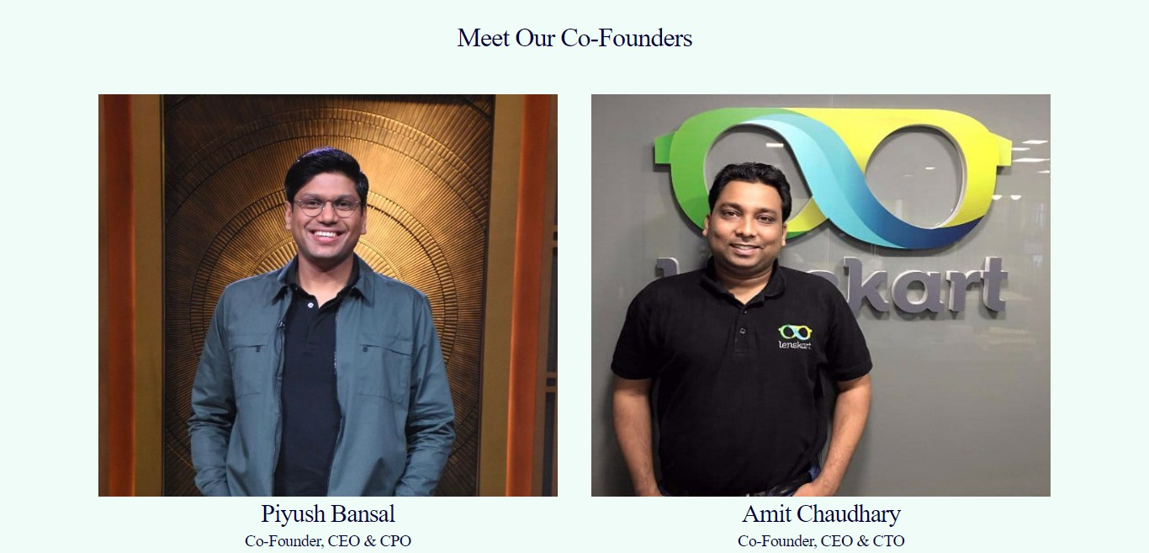

Slide 6
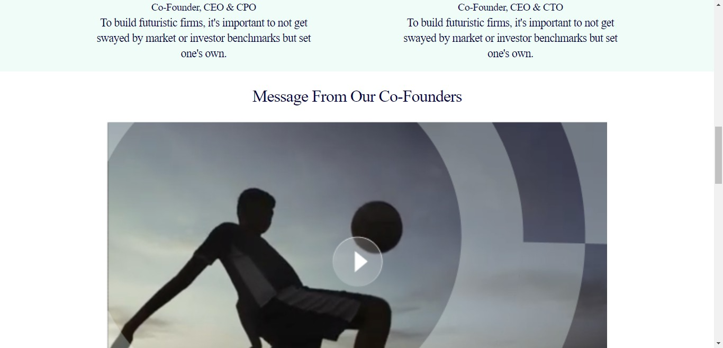

Slide 7


Slide 8
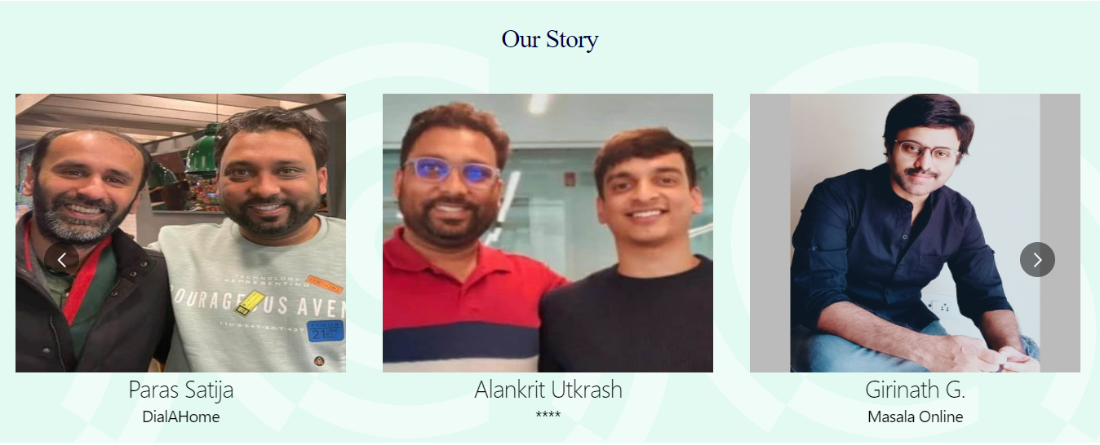

Slide 9


Slide 10
About Us

Slide 11


Slide 12
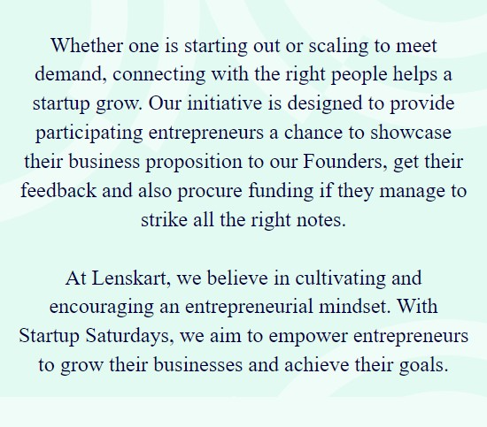

Slide 13


Slide 14
Contact Us

Slide 15
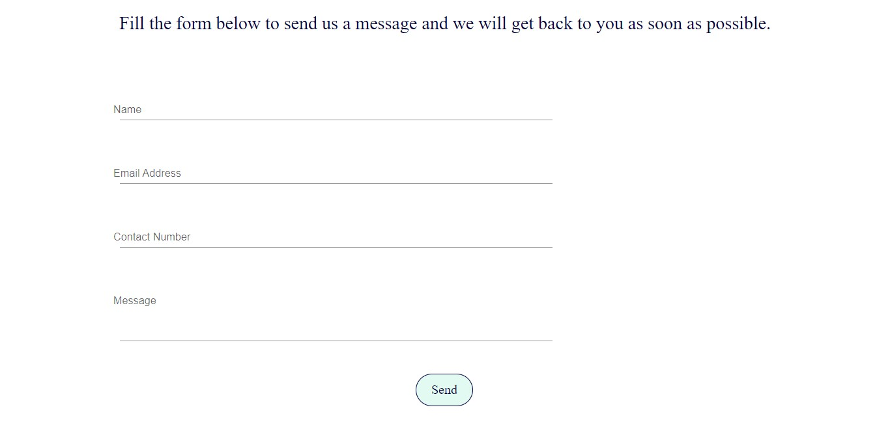

Slide 16
End

